Slide 1

Blog Website with Database
Mini Project (KCS-752)
Submitted to:
Neha Singh
By:
Akashdeep Soni (1816410036)
Abhishek Omar (1816410016)
Branch and Section: CS-4B

Slide 2

Blog Website with Database

Slide 3
Table of Contents
Introduction
Technology Used
Hardware and Software Used
Feasibility Study
Project
Snapshots
Flow Chart
Benefits
Applications
Conclusion
References

Slide 4
Introduction
A blog is basically a website which is used for chronological listing of blog posts.
Blog website will motivate people to write ideas, confession or anything they want to express
The idea is to build a public blog website using latest technology and tools.
This website provide the functionality to compose blogs, read blogs and delete the blogs at the same time.

Slide 5
Technology Used
Web Technology
Web Technology refers to the various tools and techniques that are utilized in the process of communication between different types of devices over the internet. A web browser is used to access web pages.
Web browsers can be defined as programs that display text, data, pictures, animation, and video on the Internet.
It will have all the CRUD operations using MongoDB database and Nodejs REST API.

Slide 6
Technology Used (Cont...)
Frontend
HTML,CSS,Javascript
EJS (Dynamic Pages)
Backend
Node.js
Express.js (Framework)
Database
MongoDB
Mongoose (ODM)

Slide 7
Hardware and Software Used
Hardware used
Processor: i3 or better
RAM: 2GB or more
Storage: 2GB or more
Software used
Editor: Visual Studio Code
Browser: Chrome or Firefox
Version Control: Git

Slide 8
Feasibility Study
Technical Feasibility
All the library and tools are open source and free to use. So, the technical team are capable of converting the ideas into working system.
Economical Feasibility
The viability, cost and benefits of the project are feasible because it does not require any extra hardware and all the resources are open source and free.
Operational Feasibility
This project met all the organizational needs and can be easily used to read, delete and compose post efficiently.

Slide 9
Blog Website with Database
Task
To provide a website where anybody can compose a blog anonymously and anybody can read it.
We will also provide the functionality to delete blogs.
Constraint
There is no account registration hence the blog is public and anybody can read, compose or delete blog.

Slide 10
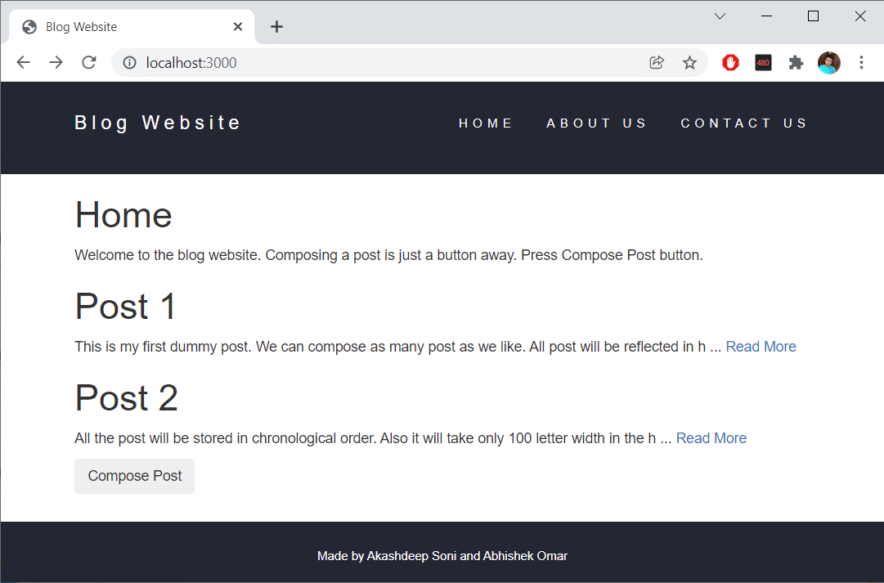
Snapshots

Slide 11
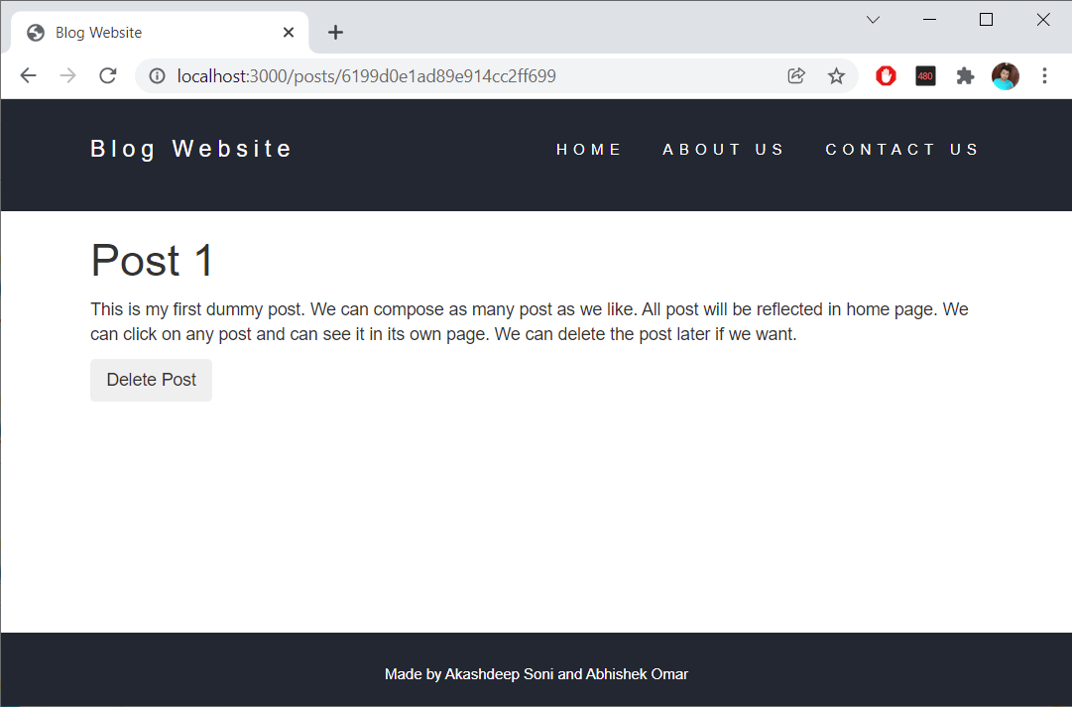
Snapshots (Cont...)

Slide 12
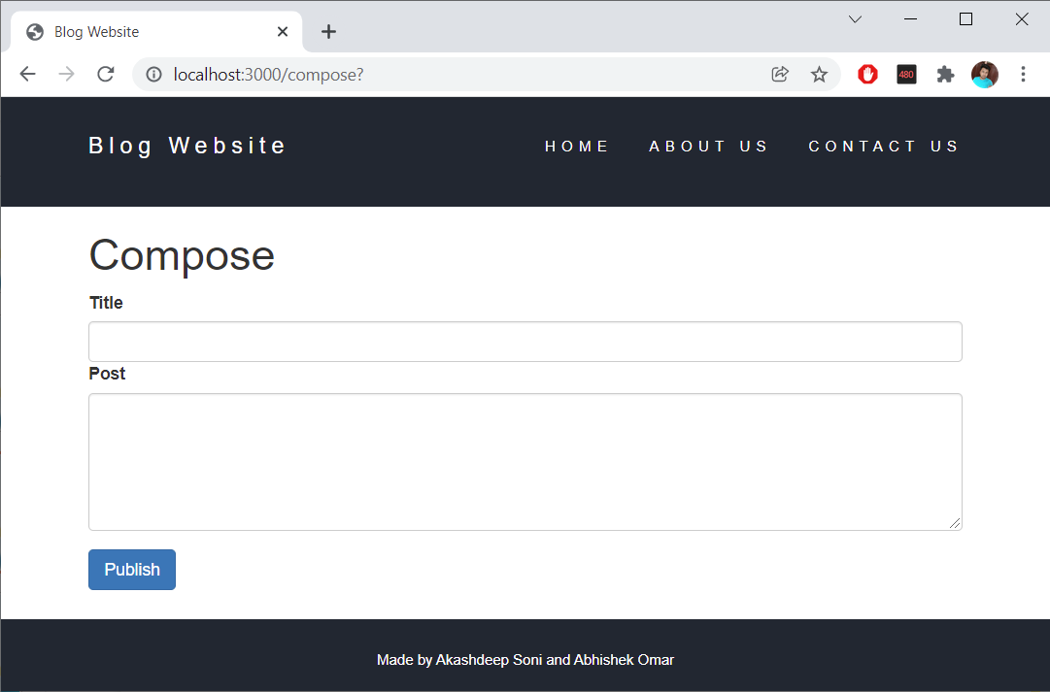
Snapshots (Cont...)

Slide 13
Flowchart
Start
Home
Homepage
Home
Read or
Compose ?
Read
Read
Compose
Compose
Delete ?
No
Post
Yes
Delete
End

Slide 14
Benefits of Blog Website
Freedom to write
Blogs are reflection of writer’s thoughts. The writer can express themselves freely. It attracts relevant people to
the website.
Use as Diary
The blogs appear in chronological order so we can update daily events as a story on blog website.
Connect with Others
Readers can comment their opinion on the respective blogs hence we get the feedback from others. We can also interact with them.

Slide 15
Applications of Blog Website
Advertisement
We can show advertisement on our blog website inorder to redirect the audience to any sales website and make them buy product and services.
Marketing
Marketers can use blog websites to promote and sell their products. They can do reviews of their latest products and services on the website.
Share Knowledge
Blog website can be run by anyone so it gives the freedom to share the knowledge in whatever topic he or she want to.

Slide 16
Conclusion
A blog is a frequently updated online personal journal or diary. It is a place to express yourself to the world.
A place to share your thoughts and your passions. Really, it’s anything you want it to be.
For our purposes we’ll say that a blog is your own website that you are going to update on an ongoing basis.

Slide 17
References
MDN Web Docs
https://developer.mozilla.org/en-US/
W3Schools Online Web Tutorials
https://www.w3schools.com/
The Complete 2022 Web Development
https://www.udemy.com/course/the-complete-web-development-bootcamp/
Burdman, Jessica, “Collaborative Web Development” Addison Wesley
Xavier, C, “ Web Technology and Design” , New Age International
Github Link
https://github.com/Akashdeep-Soni/blog-website-with-database

Slide 18
Thank You

